Slide 1
Terminology
Sungjoon Choi
(sungjoon.choi@cpslab.snu.ac.kr)

Slide 2
Terminologies are Important

Slide 3
Input Data

Slide 4
Output / Class / Label
Cat
[1 0 0 0]
Dog
[0 1 0 0]
Cow
[0 0 1 0]
Horse
[0 0 0 1]

Slide 5
One-hot coding
Cat
[1 0 0 0]
Dog
[0 1 0 0]
Cow
[0 0 1 0]
Horse
[0 0 0 1]

Slide 6


Training / Learning

Slide 7

Dataset
Training Data
Validation Data
(Cross-validation)
Test Data

Slide 8
Neuron

Slide 9
Basic single layer network
1
2
W
4
Weight
0
+
ReLu
Input
b
Output
Bias

Slide 10
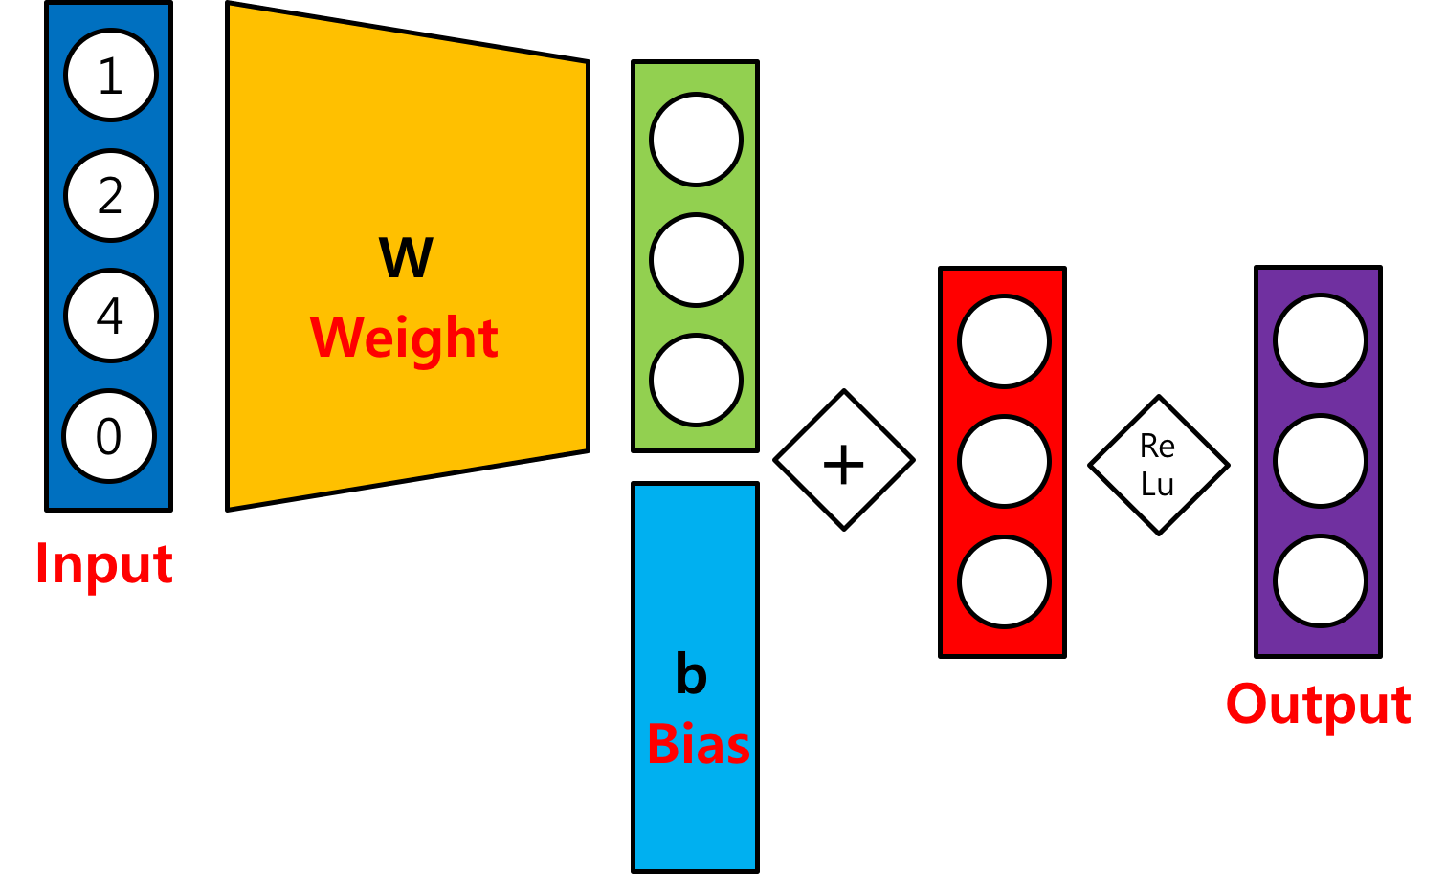
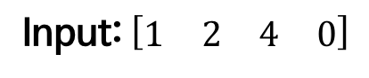
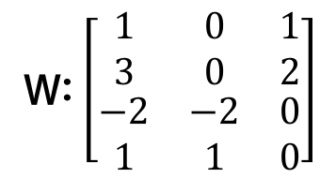
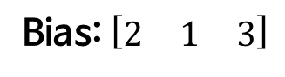
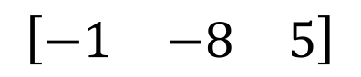
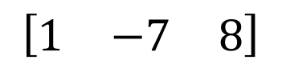
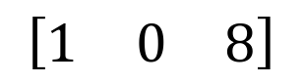
Basic single layer network
Input: $\left[\begin{matrix}\begin{matrix}1 & 2\end{matrix} & \begin{matrix}4 & 0\end{matrix}\end{matrix}\right]$
W: $\left[\begin{matrix}\begin{matrix}\begin{matrix}1 \\ 3\end{matrix} \\ \begin{matrix}−2 \\ 1\end{matrix}\end{matrix} & \begin{matrix}\begin{matrix}0 \\ 0\end{matrix} \\ \begin{matrix}−2 \\ 1\end{matrix}\end{matrix} & \begin{matrix}\begin{matrix}1 \\ 2\end{matrix} \\ \begin{matrix}0 \\ 0\end{matrix}\end{matrix}\end{matrix}\right]$
Bias: $\left[\begin{matrix}2 & 1 & 3\end{matrix}\right]$
$$\left[\begin{matrix}−1 & −8 & 5\end{matrix}\right]$$
$$\left[\begin{matrix}1 & −7 & 8\end{matrix}\right]$$
$$\left[\begin{matrix}1 & 0 & 8\end{matrix}\right]$$

Slide 11
(Neural) Network

Slide 12
Multi-Layer Perceptron

Slide 13
Activation Function

Slide 14
Epoch / Batch size / Iteration
One epoch: one forward and backward pass of all training data
Batch size: the number of training examples in one forward and backward pass
One iteration: number of passes
If we have 55,000 training data, and the batch size is 1,000. Then, we need 55 iterations to complete 1 epoch.

Slide 15
Cost function
This is just a function that we want to minimize.
There is no guarantee that it will bring us to the best solution!
It should be differentiable!

Slide 16
MNIST (Mixed National Institute of Standards and Technology)

